Slide 1
CONTEMPORARY ART AND COMMUNITY ENGAGEMENT AT VIRSERUMS KONSTHALL, SWEDEN
April, 2022 - Carolina Jonsson

Slide 2
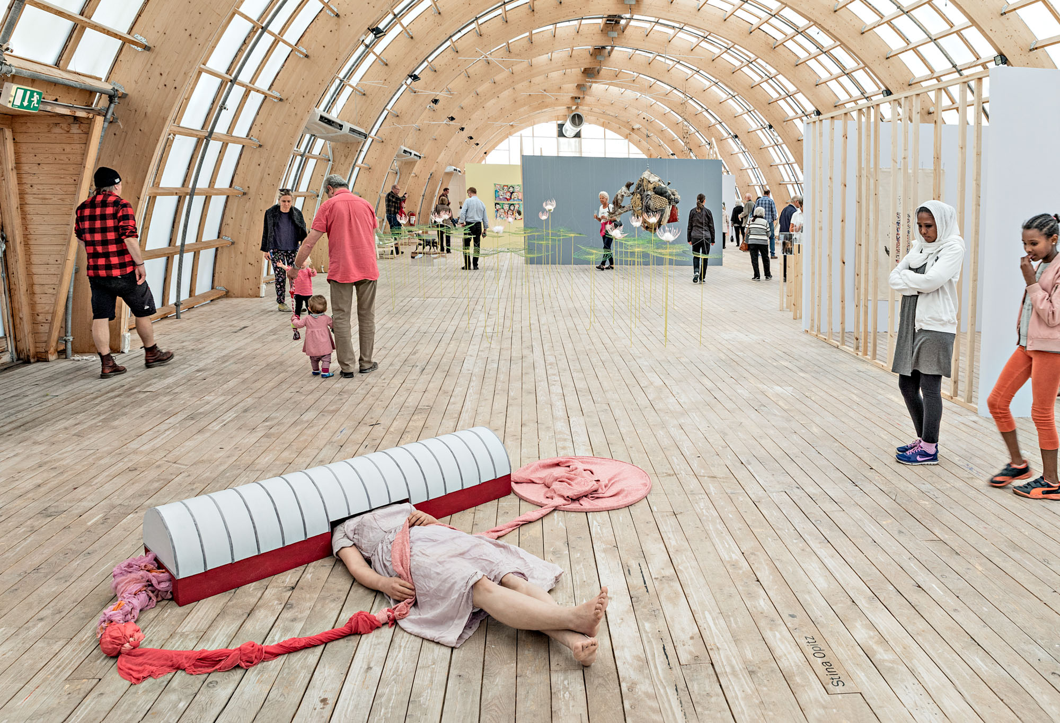

Slide 3
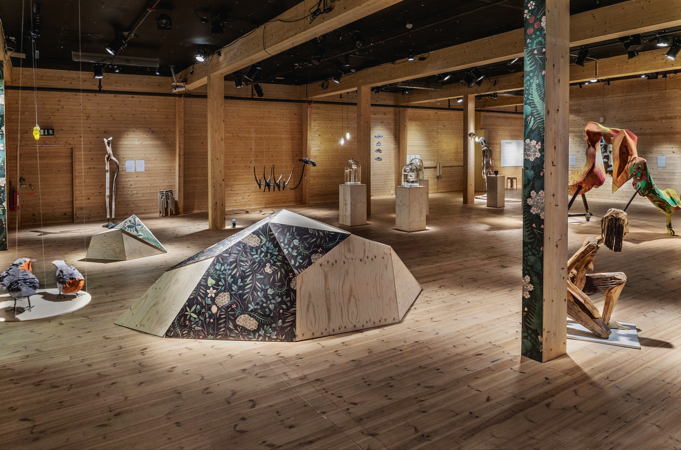

Slide 4
